Slide 1


Chapter 1
Python Programming Fundamentals

Slide 2
Python Concepts
Python is among the commonly used programming languages. It is used for Web development (server-side), software development, mathematics and more. Also, it is a high-level, interpreted, object-oriented programming language known for its readable syntax and versatility which allow programmers to express complex logic in fewer lines of code compared to other languages such as C++, Java, or PHP.
It was originally created by Guido van Rossum in the late 1980s and officially released in 1991, Python supports multiple programming paradigms, including procedural, object-oriented, and functional programming.

Slide 3
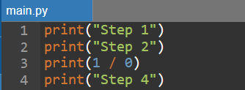
Characteristics of Python
1. Interpreted Language - It executes code line by line, as opposed to compiled languages like C or Java that are converted into machine code before running.
Example:
2. Dynamic Typing - Python uses dynamic typing, meaning that you do not declare the data type of a variable. The type is determined at runtime based on the value assigned.
Runtime error occurs here.
This will NOT run.

Slide 4
Characteristics of Python
3. High Level - A high-level language allows you to write programs in a way that is close to human language. For example, when using a function, python handles the complexity while not worrying about how it works internally. Compare this to a low-level language like machine language where every instruction should be written in form of 0 and 1 and it’s very challenging to understand and use as primary language.
4. Multi-paradigm - Python supports multiple programming styles, which makes it highly flexible and adaptable to different types of projects. It supports procedural, object-oriented, and functional programming styles.

Slide 5
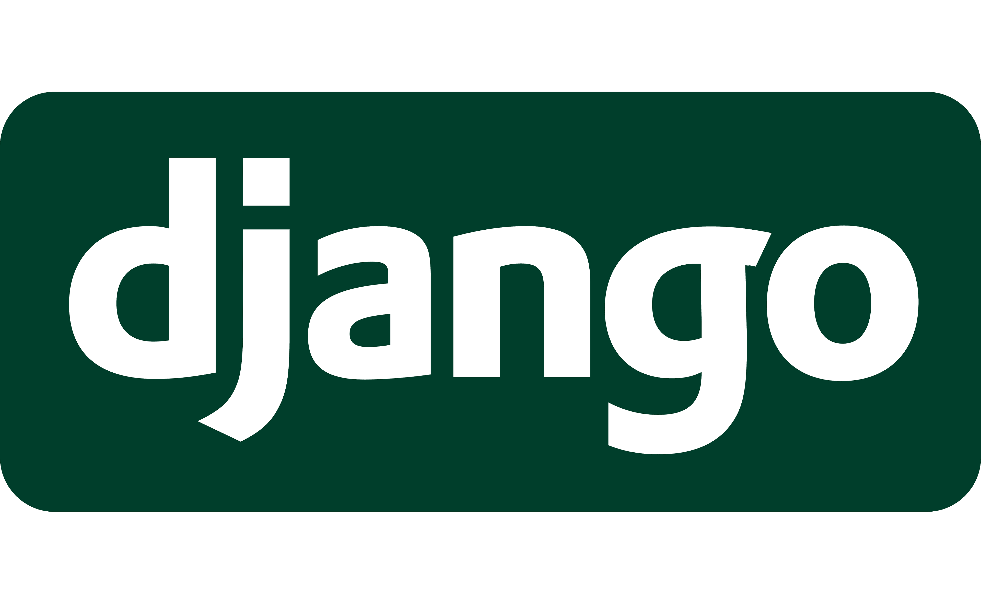
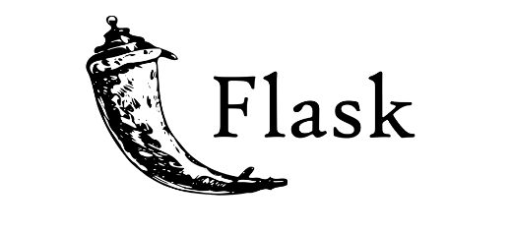
Use Cases of Python
1. Web Development - Python is widely used to build the back end (server-side) of web applications. It offers robust frameworks like Django and Flask, which help developers create secure, scalable, and maintainable websites and APIs.
Frameworks:
- Django: A high-level framework that follows the "batteries included" philosophy which includes everything needed to build a full-featured web app quickly.
- Flask: A lightweight framework that gives developers more control and flexibility.

Slide 6
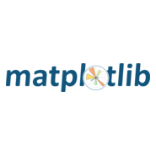
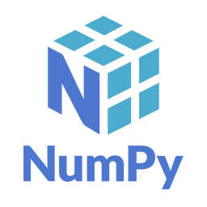
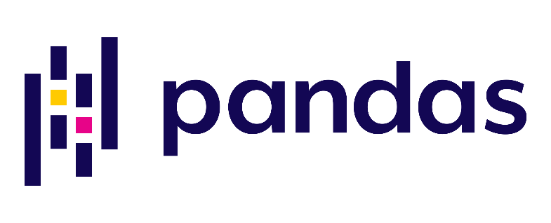
Use Cases of Python
2. Data Analysis and Machine Learning - Python is a favorite in the data science world because of its simple syntax and powerful libraries for data handling and machine learning.
Libraries:
NumPy: For numerical computing and array manipulation.
pandas: For structured data handling (like tables, CSV files, Excel files).
Matplotlib: For data visualization.

Slide 7
Use Cases of Python
3. Automation and Scripting - Python is excellent for automating repetitive tasks, also called scripting. It's commonly used for file operations, sending emails, renaming files, scraping websites, and more.
4. Software Testing and Prototyping - Python is widely used in software development for writing test cases and quickly creating prototypes of applications.
5. IoT, Robotics, Game Development, and Cybersecurity - Python also extends into emerging and technical fields, offering tools for interacting with hardware, developing games, and building secure systems. For example, Raspberry Pi which is used to control sensors and devices.
Notes:
3. Automation and Scripting
Automation means using a program to perform tasks automatically instead of doing them manually. Python is very good for this because its syntax is simple and it has many built-in libraries for working with files, folders, the internet, and other applications.
For example, imagine you have 500 files in a folder and you need to rename them one by one. Instead of manually renaming all 500 files, you can write a Python script that does it automatically.
Python can be used for:
File operations – creating, reading, copying, moving, and deleting files
File renaming – automatically changing the names of hundreds of files
Sending emails – automatically sending reports or notifications
Data processing – automatically processing large amounts of data
Web scraping – collecting information from websites
Backup tasks – automatically copying important files to another location
Report generation – creating reports on a regular schedule
Example:
A school could use Python to automatically generate and email a weekly attendance report to teachers.
So, Python scripting helps save time and reduces repetitive manual work.
4. Software Testing and Prototyping
Python is also widely used in software testing. Testing is the process of checking whether a program works correctly and produces the expected results.
Developers can use Python to create test cases that automatically check different parts of a software application.
For example, suppose you have a login system. A Python test can check:
Can a user log in using the correct username and password?
Is login rejected when the password is incorrect?
What happens when the username is empty?
Does the system properly handle invalid input?
Instead of manually testing these situations every time the software is changed, Python can perform the tests automatically.
Python is also useful for prototyping. A prototype is an early or simplified version of an application used to test an idea before developing the complete system.
For example, if a developer wants to create a student enrollment system, they can first use Python to quickly create a basic version to test:
How students will enter their information
How subjects will be selected
How enrollment records will be stored
How the system will display results
Once the prototype works, the developer can improve it and build the complete application.
In short: Python helps developers test software efficiently and quickly turn ideas into working prototypes.
5. IoT, Robotics, Game Development, and Cybersecurity
Python is not limited to traditional software applications. It is also used in several technical and emerging fields.
Internet of Things (IoT)
IoT, or Internet of Things, refers to physical devices that can collect, process, and exchange data through a network.
Python can be used to communicate with sensors and control electronic devices.
For example, a Raspberry Pi can run Python programs and be connected to:
Temperature sensors
Motion sensors
Cameras
LEDs
Motors
Relays
Other electronic devices
A Python program could read the temperature from a sensor and automatically turn on a fan when the temperature becomes too high.
Example:
Temperature sensor → Raspberry Pi → Python program → Fan turns ON
This makes Python useful for creating smart devices and IoT systems.
Robotics
Python can also be used in robotics to control and communicate with robotic components.
For example, a Python program can be used to:
Read sensor information
Control motors
Process camera images
Make decisions based on sensor data
Control the movement of a robot
Game Development
Python can also be used to create games. Libraries such as Pygame provide tools for creating:
Characters
Game controls
Sound effects
Animations
Collision detection
Game levels
Python may not be the dominant language for large commercial games, but it is excellent for learning game development and creating smaller games and prototypes.
Cybersecurity
Python is also commonly used in cybersecurity because it can automate tasks and process large amounts of information.
For example, Python can be used for:
Log analysis
Security testing
Network monitoring
Automating security tasks
Processing security data
Developing defensive security tools

Slide 8
Learning Activity 1: Match the concept
Concept | Definition
1. Interpreted | A. Variables do not need a declared type; their type is determined at runtime.
2. Dynamic Typing | B. Code is close to human language and hides low-level system details.
3. High-Level Language | C. The program is executed line by line rather than compiled beforehand.
4. Object-Oriented | D. Uses functions as building blocks and treats them as data.
5. Functional Programming | E. Organizes code using objects that contain data and behavior.

Slide 9
Learning Activity 2
Identification: Write the correct answer in the space provided.
 | 1. | Python was created by ___________________.
 | 2. | A lightweight framework that gives developers more control and flexibility
 | 3. | Python executes code line by line which makes it a/an ____________ language.
 | 4. | It is used for numerical computing and array manipulation.
 | 5. | It would be most useful for creating graphs and visualizations.
 | 6. | True or False: Variable types are assigned at runtime.
 | 7. | True or False: High-level languages allow writing programs closer to machine language
 | 8. | True or False: Python is a statically typed language.
 | 9. | True or False: Python supports multiple programming paradigms.
 | 10. | Flask is used for data visualization.
Guido van Rossum
Flask
interpreted
NumPy
Matplotlib
True
False
False
True
False

Slide 10

Why Learn Python
Python has become one of the most popular programming languages in the world and not just by chance. Here are the reasons why:
1. Beginner-friendly - Python is known for its clear and readable syntax. You don’t need to memorize complex rules or structures just to write your first program. It reads almost like English, making it easier to understand what each line of code does.
For example: Python simply executes the command and prints the message. No semicolons, no class definitions, no main() function required.

Slide 11
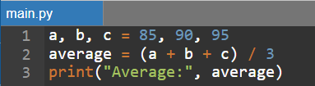
Why Learn Python
2. Fast Learning Curve - Python is so readable and intuitive where beginners can pick it up faster than other programming languages.
For example, instead of writing 6-10 lines of code to calculate the average of three numbers, python lessen it since there are no more data type declarations:

Slide 12
Why Learn Python
3. Free and Open-source - Python is 100% free to use. You don’t need to pay for a license or subscription, and it’s available for Windows, macOS, and Linux. So, if anyone wants to build a data dashboard, they can freely use libraries like pandas and matplotlib.
4. Versatile and Flexible - Python can be used in a wide range of fields, making it a flexible language for different interests and career paths.
Whether you're a future web developer, data analyst, scientist, or game designer, Python has tools for you.
Web apps using Django or Flask
Data science using NumPy and pandas
ML using scikit-learn or TensorFlow
Games using Pygame
Automation using scripts

Slide 13
How python become popular?
Characteristic | How It Helps
Simple syntax | Makes code easier to read, write, and maintain even for beginners.
Interpreted language | It can run code directly without compiling, which speeds up testing and learning.
Dynamic typing | It doesn’t need to declare variable types, allowing quicker development.
Large standard library | Includes built-in tools for math, file handling, web access, and more.
Cross-platform | Python works on Windows, macOS, and Linux without major code changes.
Community support | Millions of developers contribute solutions and tools that make your work easier.

Slide 14
Implementation of Python Environment
Before writing any Python code, it's important to prepare the tools that make coding, testing, and running programs easy and efficient. These tools together form Python development environment.
1. Python Interpreter - The Python interpreter is the core software that runs your Python programs. It reads your .py file line by line and translates it into actions your computer can perform. Without the interpreter, your code is just plain text, thus the interpreter gives it meaning.
Example:

Slide 15
Implementation of Python Environment
2. Code Editor or IDE - This is where you write your Python code.
Types of editors:
- IDLE – comes with Python installation, great for beginners.
- VS Code – a powerful, customizable editor.
- PyCharm – a full IDE for serious Python development.
- Jupyter Notebook – ideal for writing code with explanations and outputs (often used in data science).

Slide 16


Implementation of Python Environment
3. Terminal or Command Prompt - This is a text-based interface where you can run commands like launching Python scripts or navigating folders.
Example:
When running a python script, use either of the following commands on the root directory of the file/s:

Slide 17
Implementation of Python Environment
4. Package Manager - pip is Python’s package installer to add external libraries.
Example:
Installing
pip install flask
Uninstalling
pip uninstall flask
Upgrading
pip install --upgrade flask

Slide 18
File Management
Python scripts are saved with the .py file extension. It is good practice to organize scripts in separate folders based on topic or project. This helps avoid confusion and makes your workspace cleaner.
PythonProjects/
├── Lesson1/
│ └── hello.py
└── Lesson2/
└── calculator.py

Slide 19
How to run code using the IDE
1. Using IDLE
  Open IDLE
  Click File > New File, write your code.
  Save file with a .py extension
  Press F5 or Click Run > Run Module to see the output.
2. Using VS Code
Create new .py file.
Press Ctrl + Shift + P > Python; Run Python File in Terminal to run or Open the integrated terminal then run the following command:
  py <filename.py>
  python <filename.py>

Slide 20
Installation of Python Application and Interpreter
What is Python Application and Interpreter?
Python Application: the official software package containing everything needed to run Python.
Interpreter: the program that executes Python code line by line. Without it, your computer cannot understand Python.
Think of Python as a new language. The interpreter acts like a translator that converts your words into something the computer understands.

Slide 21
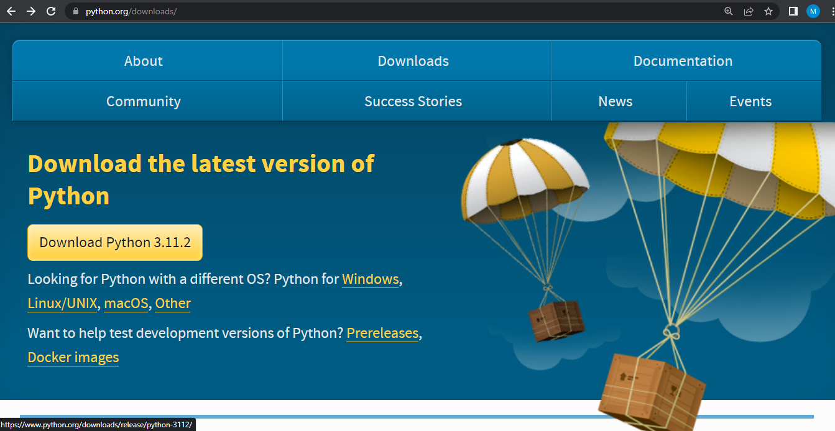
Installing Python
Step 1: Download Python - Go to the official Python website: https://www.python.org/downloads/. Choose the correct version for your OS (Windows, macOS, Linux).

Slide 22
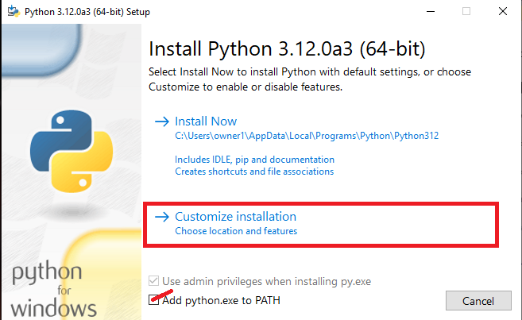
Installing Python
Step 2: Run the installer
Check on “Add python.exe to PATH” then select “Customize installation”.

Slide 23
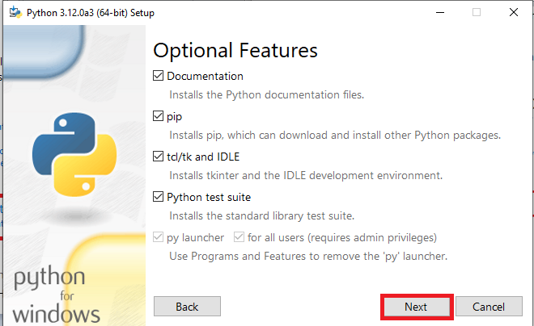
Installing Python
Step 2: Run the installer
Before clicking Next, make sure to check all the following.

Slide 24
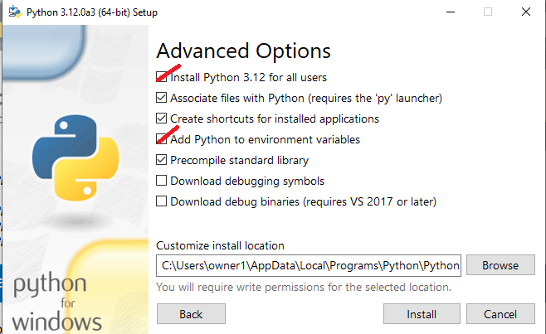
Installing Python
Step 2: Run the installer
Check on “Install Python 3.12 for all users” and “Add Python to environment variables” then, click install. A dialogue box will appear, click “Yes” then wait for the installation to be done.

Slide 25
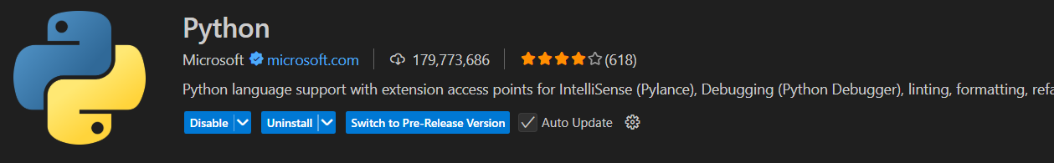
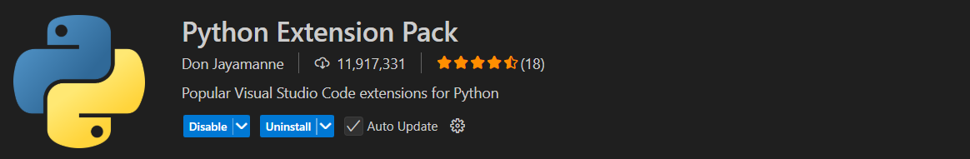
Installing Python (VS Code)
Step 1: On your VSCode, go to extensions and download the following extensions
Step 2: Create python file then run the program to test.

